Slide 1
African network on Tribocorrosion
Professor Peter A olubambi
Department of Chemical Engineering
University of Johannesburg, South Africa
polubambi@uj.ac.za; polubambi@gmail.com

Slide 2
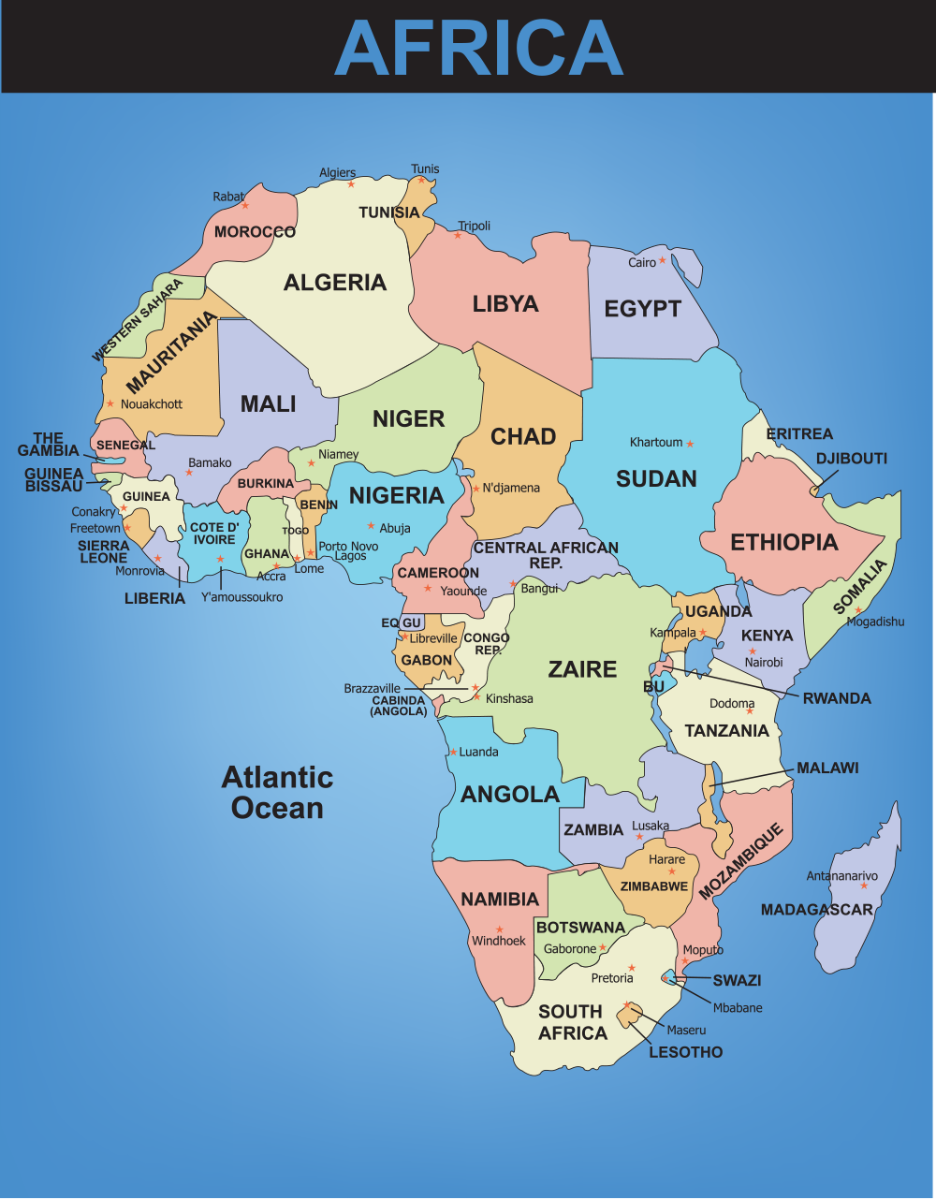
Federal University of Technology Akure, Nigeria
Obafemi Awolowo University, Ile-Ife, Nigeria
Kwame Nkruma University of Science and Technology, Kumasi, Ghana
Council for Scientific and Industrial Research, Pretoria, South Africa.
Botswana International University of Science & Technology, Botswana.
Tshwane University of Technology, Pretoria,
South Africa
University of Namibia
Namibia
University of Johannesburg, South Africa
University of the Witwatersrand, Johannesburg, South Africa
Nelson Mandela Metropolitan University, Port Elizabeth,
South Africa
Vaal University of Technology, Vanderbijlpark, Johannesburg
South Africa

